Slide 1
NFSAW Field Trip Program:

Slide 2
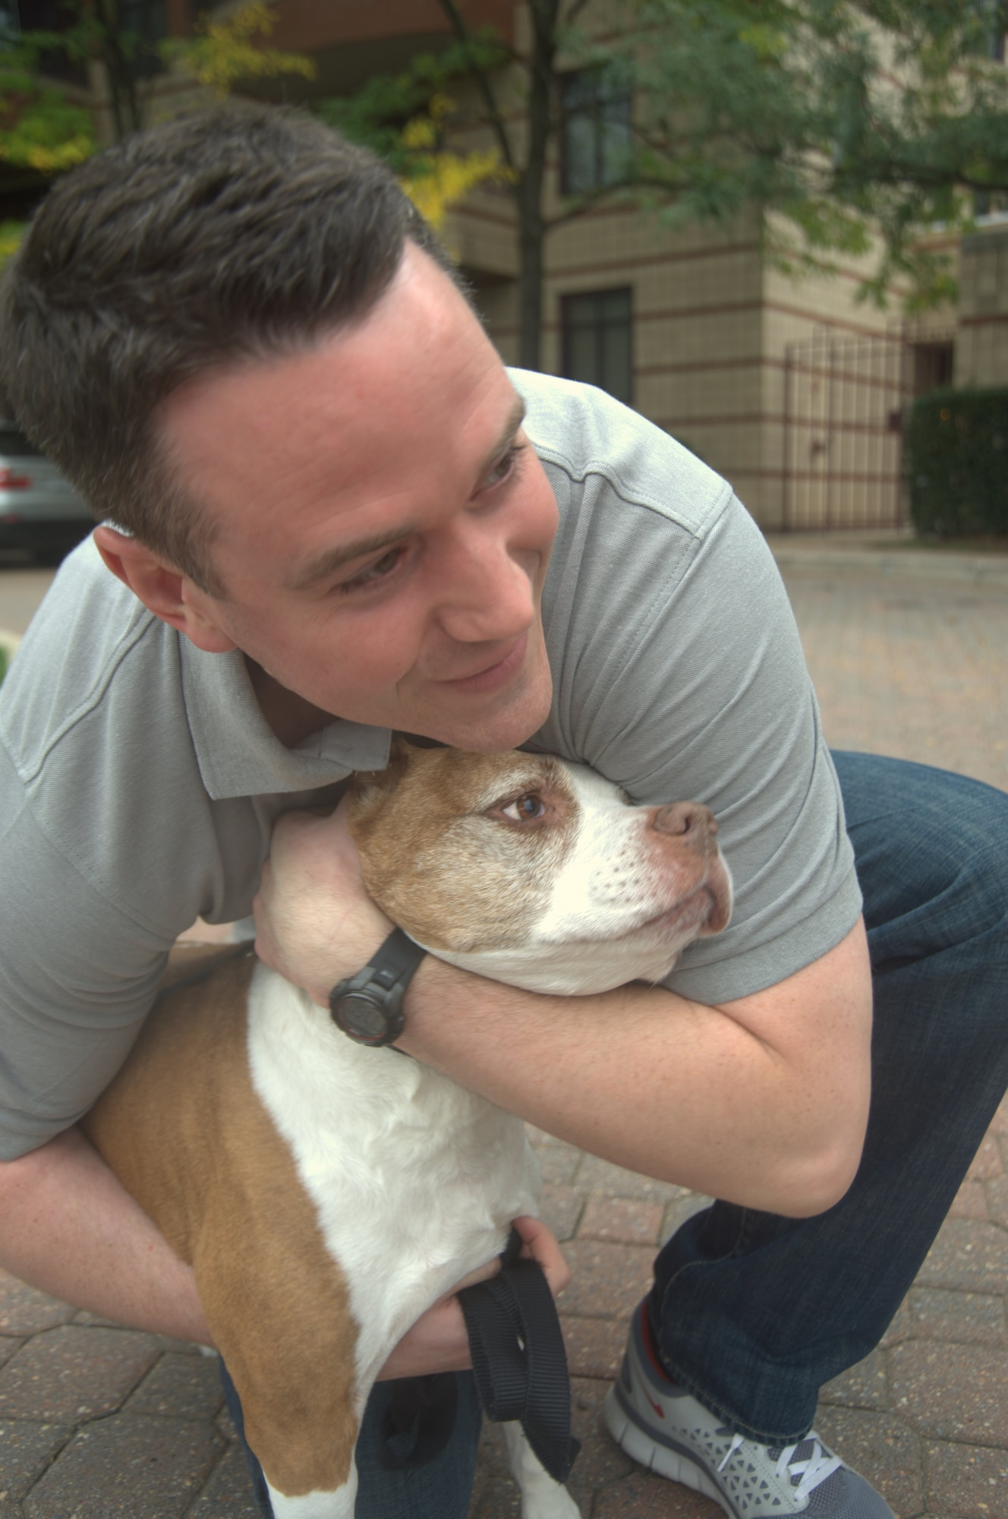
Getting to Know the Dogs
Behavior Colors:
Green- Able to be handled safely by the average person with novice dog behavior skills.
Blue- May be fearful, a strong puller or need work on basic obedience/manners.
Yellow and Orange- Requires a higher skill level for safe handling.
Upon your return you will be asked to fill out a report card on the dog’s behavior and interactions while on your adventure.

Slide 3
Body Language
Anxiety
Wrinkled brow
Muzzle-licking
Tension
Fear
Whale eye
Slinking
Cowering
Frustration
Barking
Pacing
Pawing
Nipping
Depression
Shut down

Slide 4
Handling and Maintaining Control
Collar and/or harness
Leash
Other supplies
Stay alert
Be visible
Distance and distraction
Rewards and praise

Slide 5
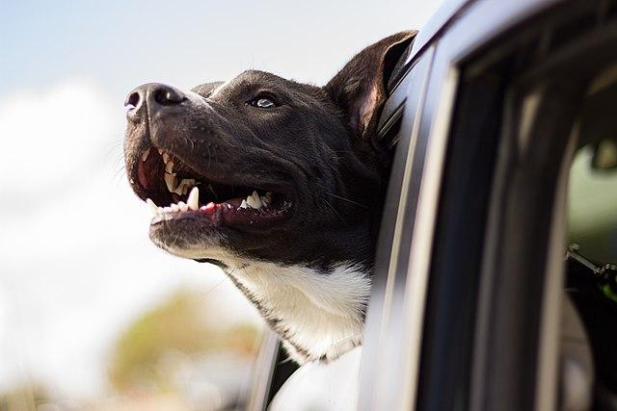
What can you do and where can you go?
What can’t you do and where shouldn’t you go?
Car Rides
Drive Thrus (Starbucks even offers a “Puppuccino”)
Your home
Sparsely populated hiking trails/outdoor areas
Uncrowded dog friendly patios/restaurants
Heavily populated hiking trails/outdoor areas
Crowded patios/restaurants
Off-leash dog parks or other off-leash areas

Slide 6
Introductions
With your personal pet(s):
Ask to do a dog meet at the shelter before your field trip to see who would be a good fit!
With any other pet(s):
Keep away from other pets in the community to avoid conflict and disease.

Slide 7
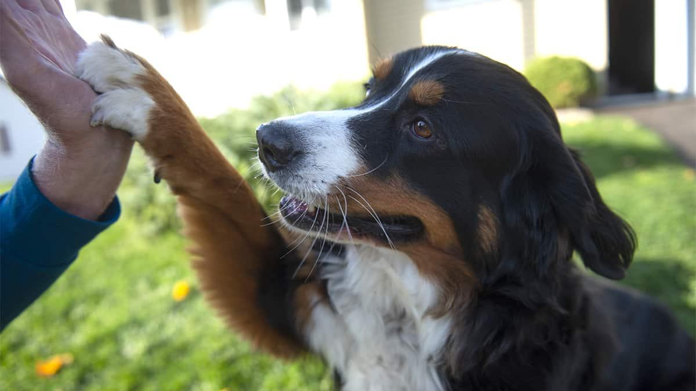
Questions?
Phone: (203)746-2925
Email: nfsaw@att.net

